Slide 1

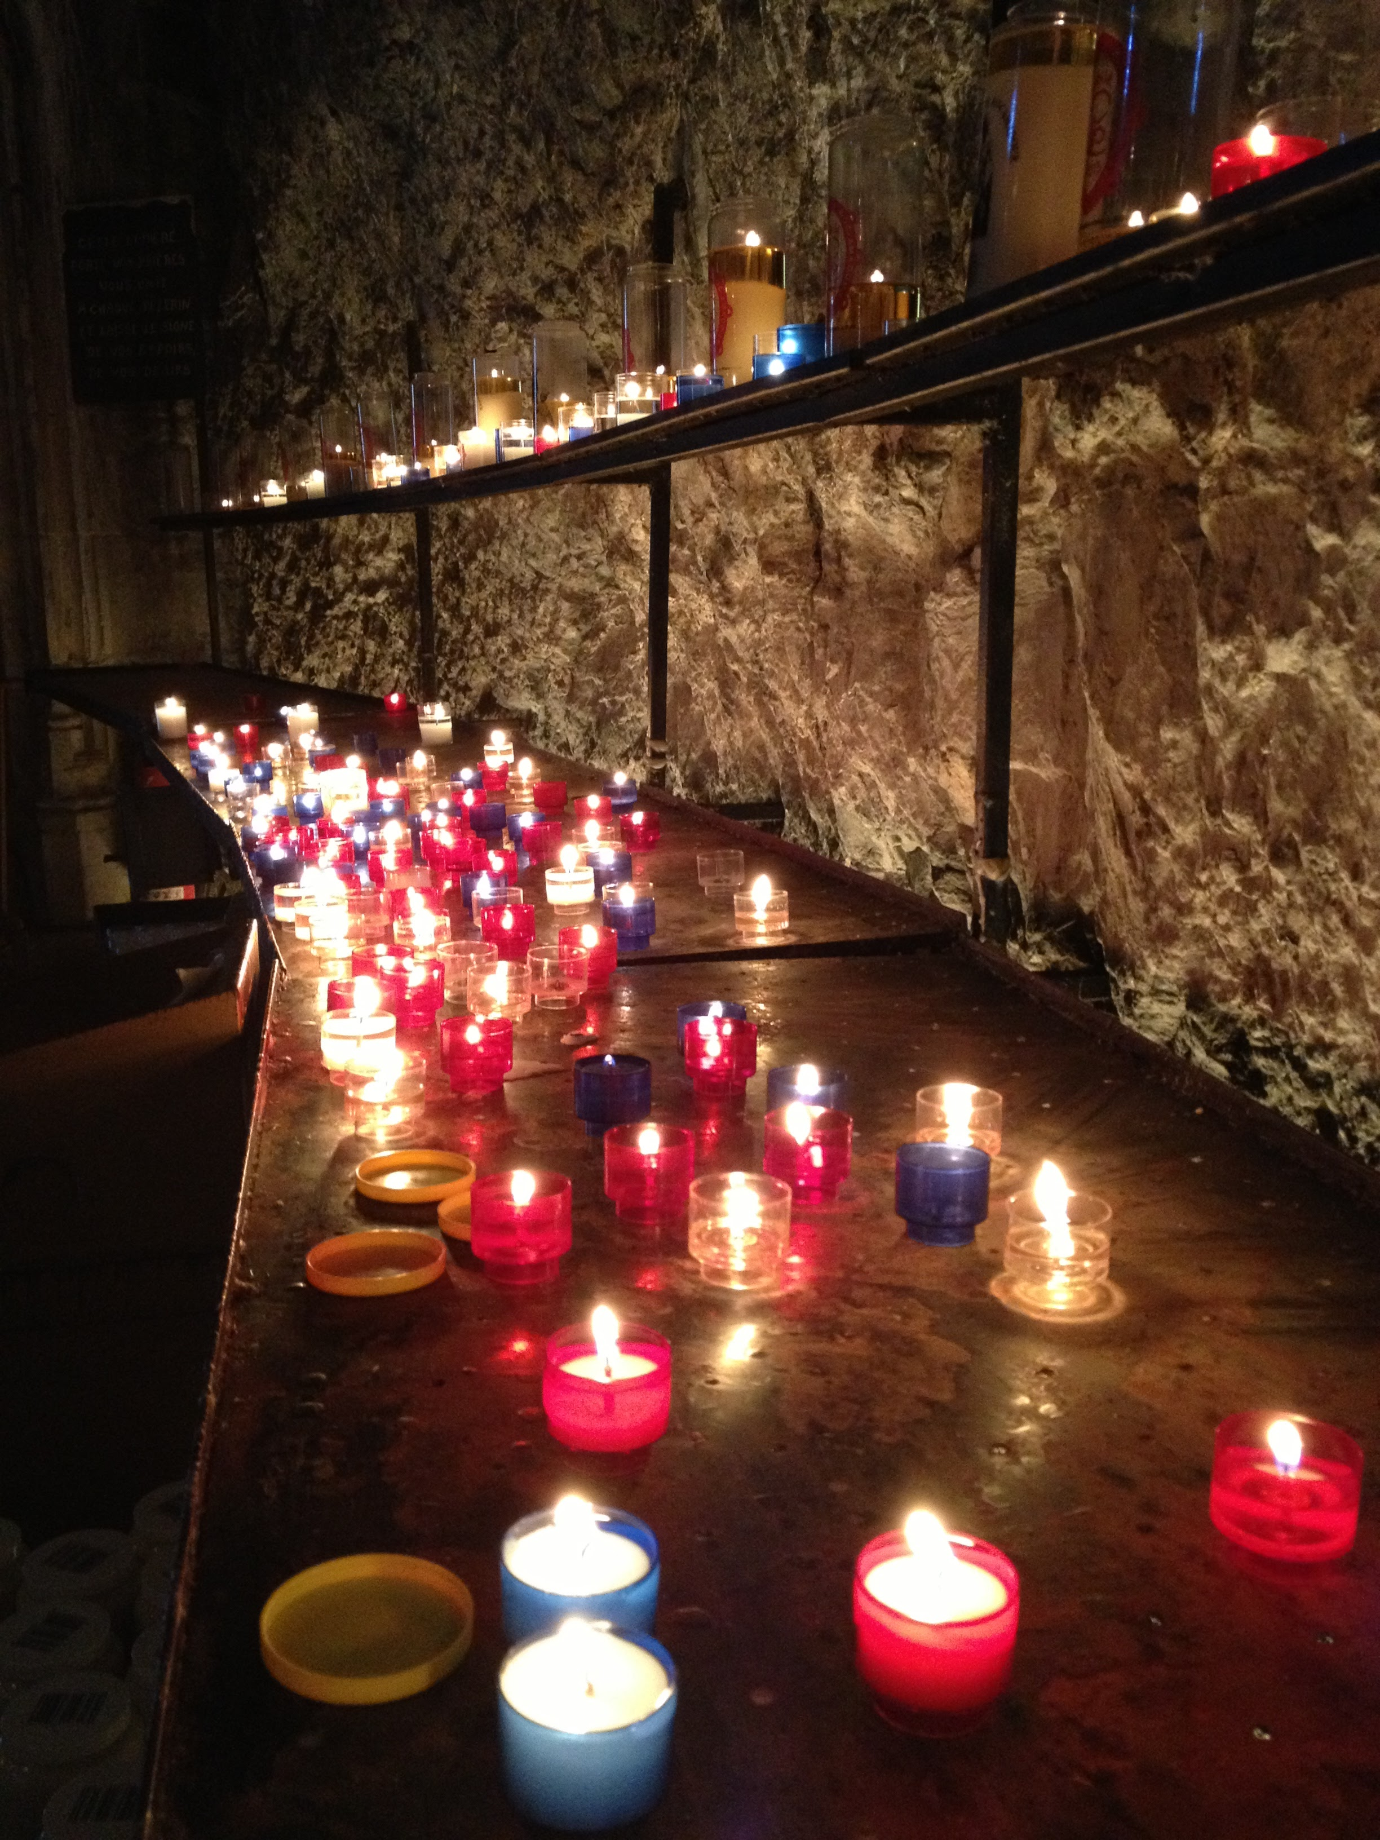
  Welcome
  …to this year’s annual Advent calendar for teachers and chaplains to use in secondary schools.
  We are the Catholic Agency for Overseas Development, reaching out to people living in poverty with practical help, whatever their religion or culture. We also campaign for global justice, so that every person can live a full and dignified life.
  This calendar tells stories of people that we work with and of young people who support this work. Each day also reflects on scripture from the Mass of the day and gives a question to ponder, a prayer and an action.
  Enjoy your Advent journey!

Slide 2
Advent calendar 2021
28
Nov
“The true light,
which enlightens everyone,
was coming into the world.”
John 1:9
25
Dec
29
Nov
24
Dec
30
Nov
23
Dec
1
Dec
22
Dec
2
Dec
21
Dec
3
Dec
20
Dec
4
Dec
5
Dec
6
Dec
7
Dec
8
Dec
9
Dec
10
Dec
11
Dec
12
Dec
13
Dec
14
Dec
15
Dec
16
Dec
17
Dec
18
Dec
19
Dec

Slide 3
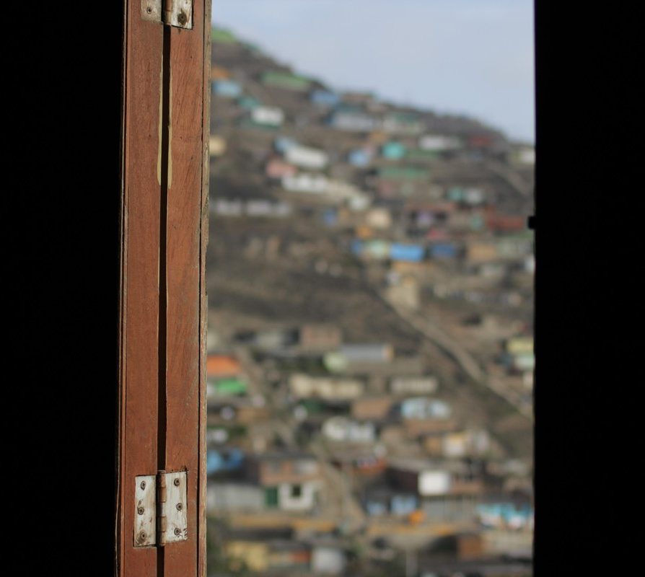
Sunday 28 November
First Sunday of Advent
“Stay awake, because you do not know when the master of the house is coming.”
Mark 13:35
  Wake up!
  Waiting has been a big part of this year - waiting for a jab or a test result, waiting to see if school was open again, waiting in petrol queues...
  Many communities that CAFOD works with eagerly awaited world leaders’ decisions at their COP26 meeting to tackle climate change. (More on that later in this calendar).
  Advent is about waiting too.
Notes:
Picture credit: Gemma Salter

Slide 4
  The start of Advent is about eagerly awaiting the Lord’s return at the end of time - staying awake!
  Like the servants in today’s reading, we can become sleepy as we await Jesus’ return. Or we can stay awake, always ready to serve.
  So, what are you waiting for?
  Lord, wake us up! Help us to serve you in our sisters and brothers, so that we are ready for your return.
  Amen
“Stay awake, because you do not know when the master of the house is coming.”
Mark 13:35
Use our World Gifts Christmas poster to replace cards in class this year.
Notes:
Picture credit: Gemma Salter

Slide 5
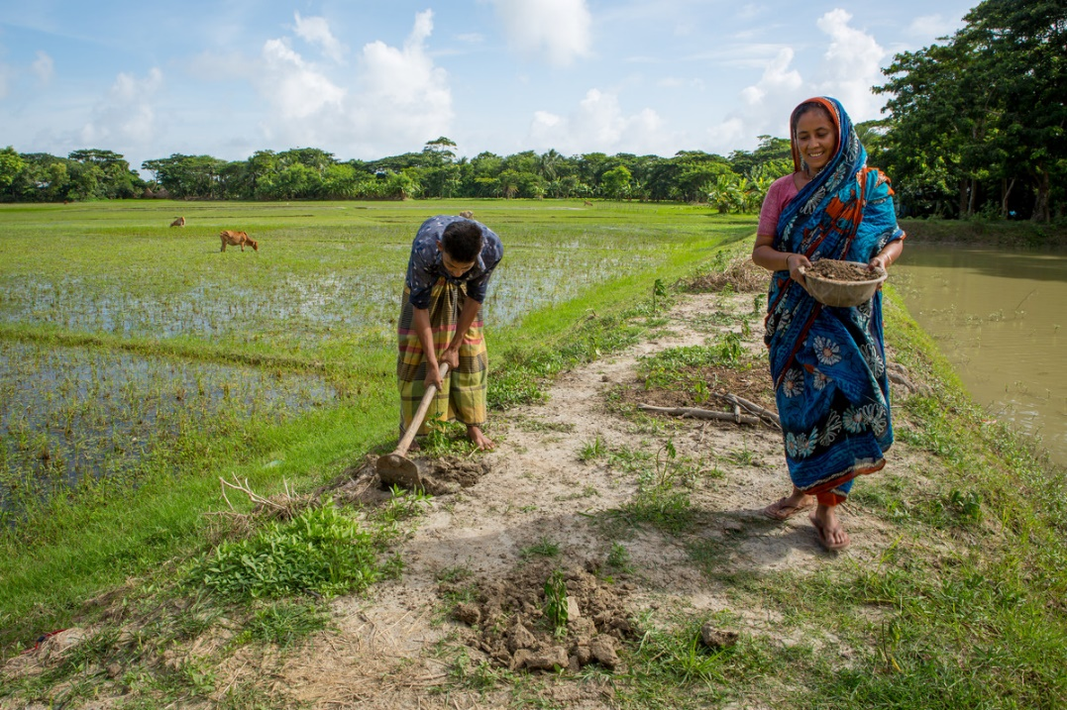
Monday 29 November
“..the glory of the Lord will be…
refuge and shelter from the storm...”
Isaiah 4:5-6
  Seeking shelter
  We first met Nomita in July 2018.
  She told us that her husband was killed in a storm and that she had raised her two children alone.
  Every year since 2007, salty water had flooded their rice field. They had no savings to rebuild and replant.
  Whenever a strong storm came, they risked losing their home and their crops.
Notes:
Picture credit: Louise Norton/CAFOD

Slide 6
  Nomita joined a CAFOD-funded project that helps people to grow crops that can survive extreme weather changes. Later in this calendar we’ll see what happened.
  Have you ever felt battered by the storms of life?
  Having faith does not mean we can avoid the storms, but it does mean we know that we always have God to rely on..
  Lord, comfort everyone today who is seeking refuge from the storms of life.
  Amen
“..the glory of the Lord will be…
refuge and shelter from the storm...”
Isaiah 4:5-6
Say this prayer for refugees or make up your own to say today.
Notes:
Picture credit: Louise Norton/CAFOD

Slide 7
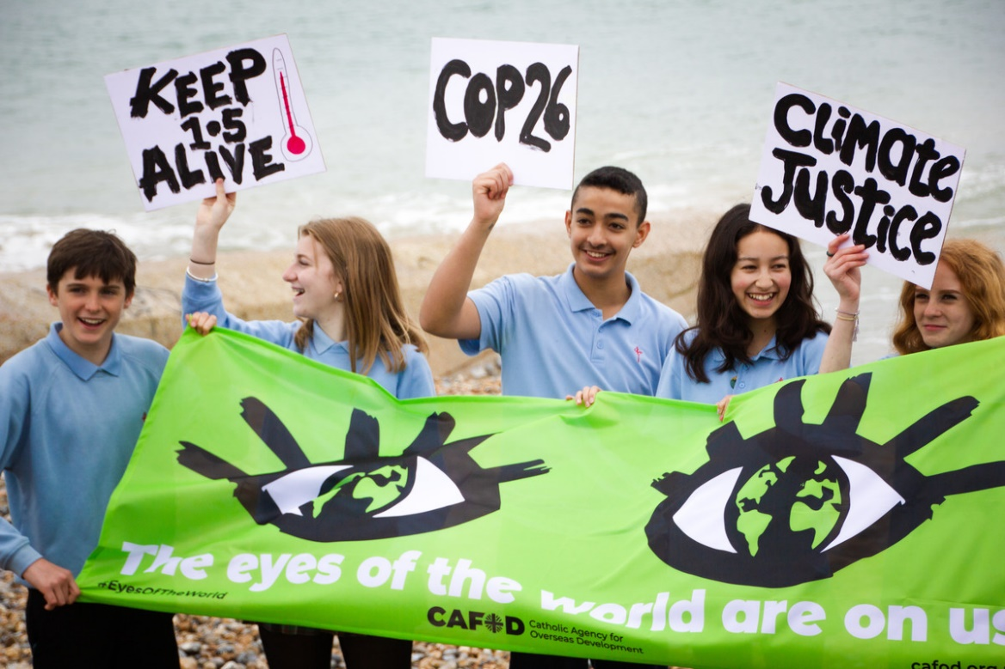
Tuesday 30 November
“In his days justice shall flourish
and peace till the moon fails.”
Psalm 71
  May justice flourish
  Were you part of our Eyes of the World banner tour this year?
  These students in Brighton were!
  Along with thousands of you, they put their faith into action and spoke out for climate justice, calling on world leaders to make decisions that would support the poorest communities on our planet.
  Vital decisions were made at the COP26 climate talks. Now we need to hold our leaders to account and call for them to go even further.
  The fight for justice continues.
Notes:
Picture credit: John Paul De Quay

Slide 8
  The first days of Advent look ahead to the fulfilment of today’s psalm, when Christ returns at the end of time, justice flourishes and there is peace forever.
  But we don’t have to wait to live in God’s kingdom – Jesus said that it is all around us. We’re called to live justly and peacefully right now!
  How will you help justice to flourish?
  Holy Spirit, inspire me with a spirit of compassion and true justice to spread your kingdom wherever I go.
  Amen.
“In his days justice shall flourish
and peace till the moon fails.”
Psalm 71
Watch our COP26 video to see how your voices were heard.
Notes:
Picture credit: John Paul De Quay

Slide 9
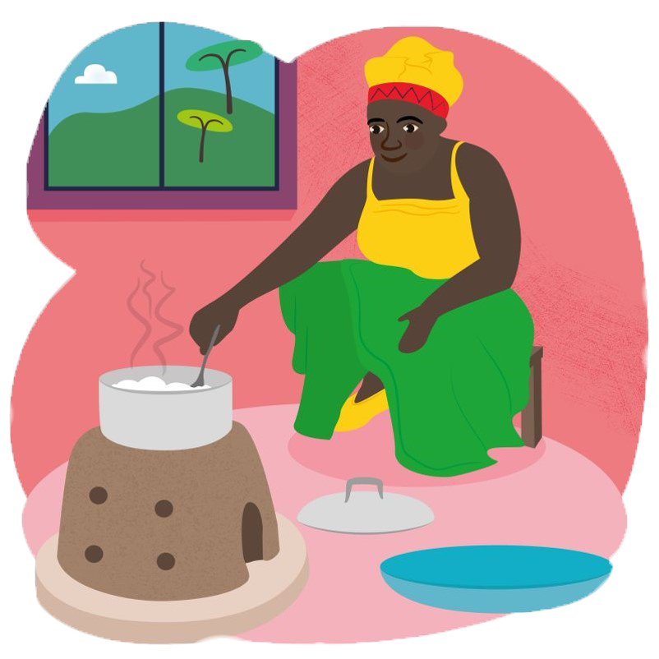
Wednesday 1 December
“The Lord God will wipe away the tears from every cheek.”
Isaiah 25:8
  World Gifts
  World Gifts are available all year, but some schools fundraise to give them as Christmas presents.
  This year, new gifts include the gift of training and materials to build an energy saving stove.
  These stoves are safer than open fires, are made with local materials and burn less fuel – protecting trees from being cut down.
  They help families to cook safely and in an eco-friendly way.
Energy Saving Stove £9

Slide 10
  The prophet Isaiah promises that God will wipe away tears. God uses our hands to wipe away tears and to offer support.
  CAFOD’s global network supports poor communities who are struggling due to the climate crisis.
  You can be part of this work through World Gifts.
  Lord, help me to be aware of other people’s sorrows today. Help me to bring comfort and hope this Advent.
  Amen.
“The Lord God will wipe away the tears from every cheek.”
Isaiah 25:8
Energy Saving Stove £9
Decide which of the World Gifts your class might buy as you prepare for Christmas.

Slide 11
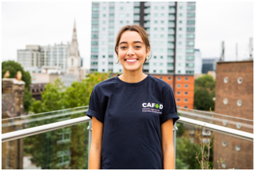
Thursday 2 December
“Everyone who listens to these words of mine and acts on them ..”
Matthew 7:24
  Taking action
  Sophie Pereira (18) is one of the eight young adults on CAFOD’s gap year programme this year.
  Sophie wants to learn about and take action for justice – that’s why she joined CAFOD.
  “Step into the Gap is a wonderful opportunity to educate myself on the global justice issues around the world and fight for global justice. It’s a great way to make a real impact.”
Notes:
Picture credit: Thom Flint/CAFOD

Slide 12
  Today’s gospel reminds us that when we act on the words of Jesus, what we do has a firm foundation.
  How can you put Jesus' words into action during Advent? And in your life choices?
  Lord, make us always ready to act on your words, “whatever you did to the least of these… you did it to me”.
  Amen.
“Everyone who listens to these words of mine and acts on them ..”
Matthew 7:27
Find out about CAFOD gap years and consider your own future.
Notes:
Picture credit: Thom Flint/CAFOD

Slide 13
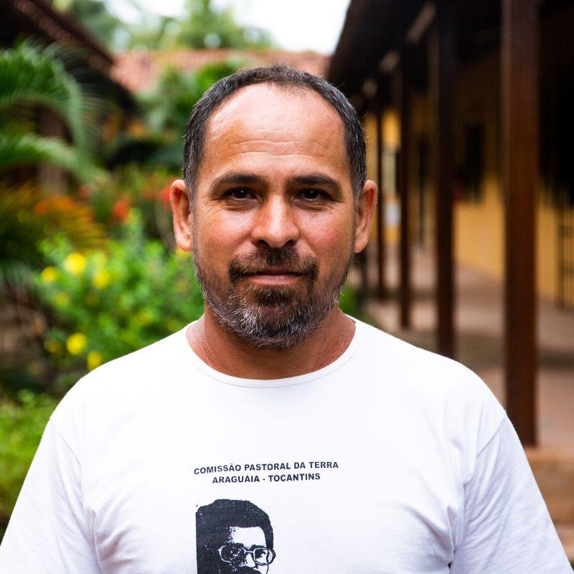
Friday 3 December
“He touched their eyes…
and their sight returned”
Matthew 9:29-30
  Seeing with new eyes
  Chiquinho is an expert in eco-friendly forest farming. He teaches families in the Amazon how to harvest forest nuts and oils, raise animals and grow native fruits and vegetables without chemicals.
  This produces a better harvest than conventional farming and enables the Amazon to recover and flourish.
  He told us: “The forest can be used by humans in a way that humans don’t dominate nature and nature doesn’t dominate humans.”
Notes:
Picture credit: Thom Flint/CAFOD

Slide 14
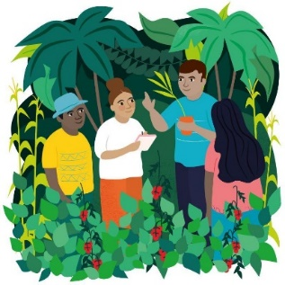
  We can all learn something new.
  If Jesus touches our hearts as he touched the eyes of the blind men in today’s reading, who knows what new possibilities we might see?
  Lord, touch my heart today so that I can see the wonders you are able to do through me. Amen.
“He touched their eyes…
and their sight returned”
Matthew 9:29-30
Find out about our Forest School World Gift.
Notes:
Picture credit: Thom Flint/CAFOD

Slide 15
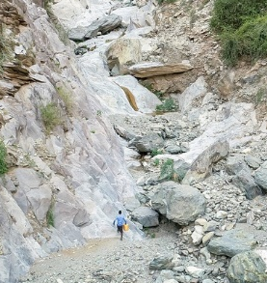
Saturday 4 December
“You received without payment; give without payment.”
Matthew 10:8
  Walking for water
During Lent, we asked you to ‘Walk for Water’ in solidarity with Abdella in Ethiopia, who walks ten hours a day just to fetch water.
Sadly, conflict in northern Ethiopia has spread this year and we can’t safely communicate with Abdella’s community at the moment. Please pray with us for their safety.
We hope that our local experts will be able to install water pumps as soon as it is safe to do so.
Notes:
Picture credit: CAFOD

Slide 16
  In today’s gospel, Jesus feels sorry for the crowds and sends out his disciples to heal them and to share the good news with them, saying:
  “You received without payment; give without payment”.
  Thousands of you reached out to others and gave without payment this year to help communities gain access to water… and had fun too!
  Thank you!
  Lord, help me to be generous of heart and always to dare to care.
  Bless Abdella’s community and give peace to Ethiopia.
  Amen.
“You received without payment; give without payment.”
Matthew 10:8
Remind yourself of Abdella’s story by watching our video.
Notes:
Picture credit: CAFOD

Slide 17
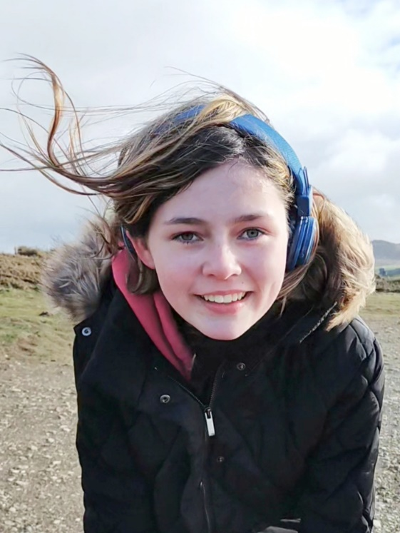
Sunday 5 December
Second Sunday of Advent
“A voice cries in the wilderness: Prepare a way for the Lord, make his paths straight.”
Mark 1:3
  Rhiannon’s story
  13-year-old Rhiannon from Dyfed was one of many of you who took part in CAFOD's 'Walk for Water' during Lent.
  Rhiannon told us:
  “It made me feel great to be helping people who struggle to get water and are not able to just turn on a tap like me. I look forward to having another opportunity like that! It was awesome.”
Notes:
Picture credit: Benita Bealby

Slide 18
  Today’s gospel tells us that John the Baptist was a voice crying in the wilderness, making straight the way for the Lord’s coming.
  We may feel our voice echoes in a wilderness and is ignored, but Rhiannon showed that no one is too young to make a difference.
  How will I influence people today?
  Lord, John the Baptist prepared the way for your coming. Help me to prepare too.
  Amen.
“A voice cries in the wilderness: Prepare a way for the Lord, make his paths straight.”
Mark 1:3
Next Lent we'll ask you to Walk Against Hunger. How could your class do this?
Notes:
Picture credit: Benita Bealby

Slide 19
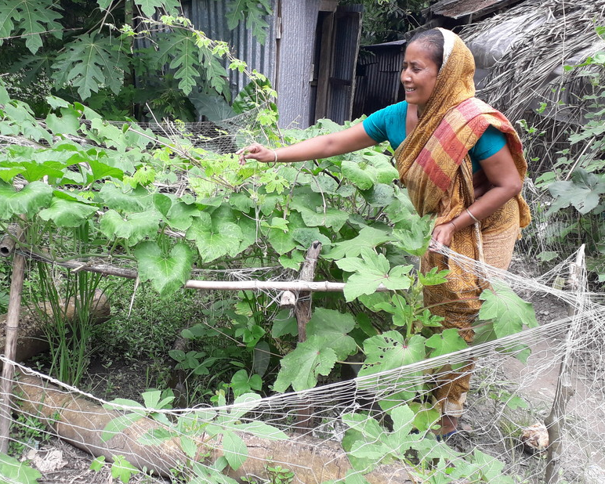
Monday 6 December
“We have seen incredible things today.”
Luke 5:26
  Simply incredible!
  Remember Nomita who lost her husband and annually had her crops threatened by floods?
  At the CAFOD-funded project that she joined, Nomita learned simple but incredibly effective techniques, like growing in sacks – to stop seeds being washed away by floods - and making raised beds. She also learned how to use organic fertiliser and how to care for crops.
  Nomita’s hard work and new skills gave her a bountiful harvest.
Notes:
Picture credit: Caritas Bangladesh

Slide 20
  Nomita says that she no longer needs to buy vegetables from the market. And, with the extra money that she earned from selling her vegetables, she was able to support her daughter Sonia’s education.
  In today’s gospel, people say they have seen incredible things.
  Growing seeds in a sack may not seem an incredible thing but for Nomita it was life-transforming.
  What simple but incredible things are you grateful for this Advent?
  Lord, thank you for your gifts. Teach me to share them.
  Amen.
“We have seen incredible things today.”
Luke 5:26
Tell one person today about something you are grateful for in the past year.
Notes:
Picture credit: Caritas Bangladesh

Slide 21
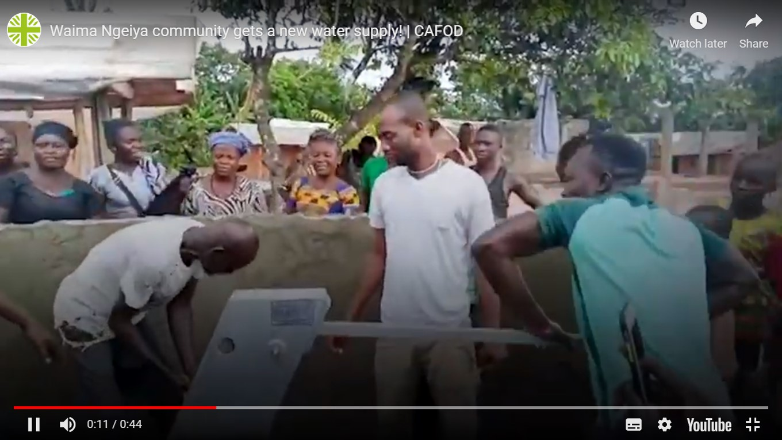
Tuesday 7 December
“‘Console my people, console them,’
says your God.”
Isaiah 40:1
  Consolation
  No vehicles could get into Waima Ngeiya village in Sierra Leone because its bridge had collapsed.
  But this year, the bridge was rebuilt, thanks to donations to CAFOD by parishes and schools in England and Wales.
  Drilling trucks could finally get through and our local experts were able to install a new water pump.
  For these villagers, access to water was a huge consolation!

Slide 22
  In today’s reading God wants to console his people through the prophet Isaiah. God also wants to console them through us.​
  It may only take a word or an understanding glance to console someone feeling downhearted.​
  How will I console people today?
  Lord, open my eyes today to see every person, made in your image, as my sister or brother.
  Amen.
“‘Console my people, console them,’
says your God.”
Isaiah 40:1
Watch the villagers celebrating the installation of their new pump.

Slide 23
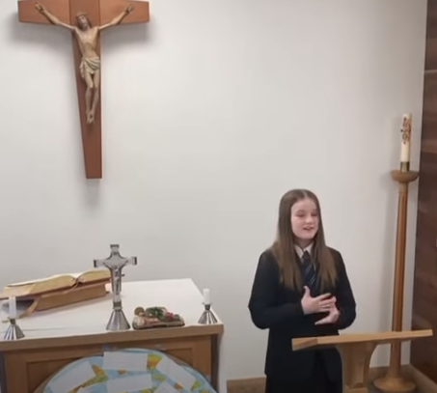
Wednesday 8 December
The Immaculate Conception
“…nothing is impossible to God.”
Luke 1:37
  Were you watching?
  After watching our 'Eyes of the World' assembly in April, students from St Martin’s Academy, Stoke Golding made a sign language message to raise awareness of the vital importance of these issues.
  And they wrote to the MP, Alok Sharma, calling for wise decisions at COP26 for the world and its people.
  Joshua said: “We pray that God will watch over it and give them wisdom as they make the decisions to control the fate of our planet.​”

Slide 24
  Today we remember the angel telling Mary that all things are possible to God, even for her elderly cousin Elizabeth to have a baby – John the Baptist.
  When we fear the climate crisis is too big to solve, let’s take heart that nothing is impossible to God.
  God our Father, you made and treasure the Earth and every person on it. Help me to do the same.
  Amen.
“…nothing is impossible to God.”
Luke 1:37
Listen and watch the students’ message being signed.

Slide 25
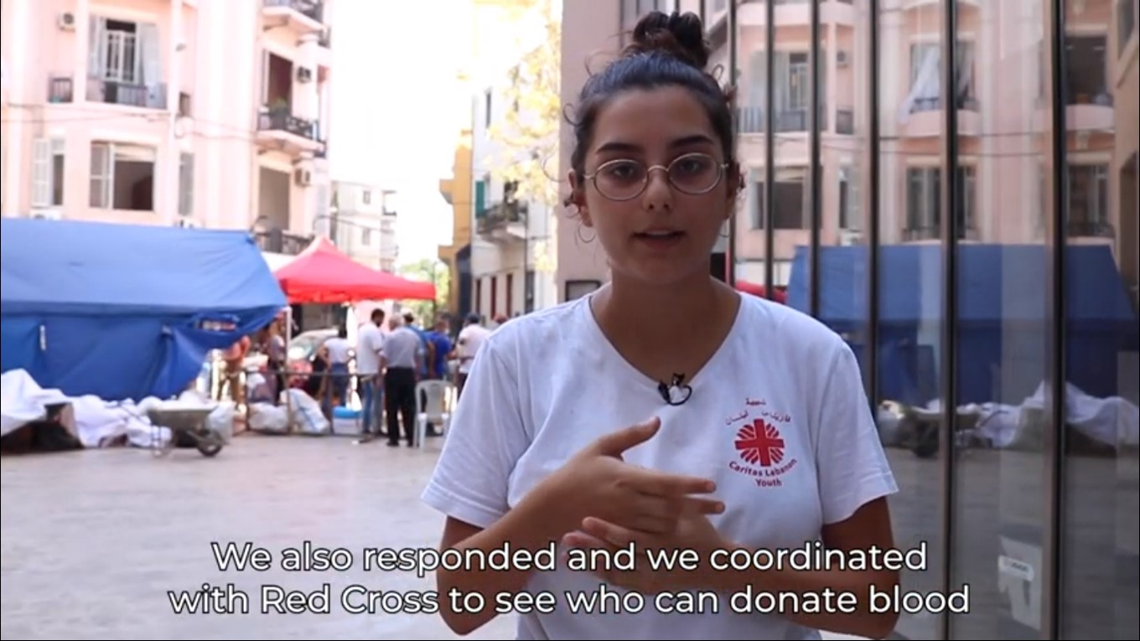
Thursday 9 December
“Do not be afraid, I will help you.”
Isaiah 41:13
  Beirut, a year on
  In August last year, a huge explosion destroyed the port at Beirut, Lebanon. Many died and 300,000 homes were destroyed.
  The Caritas network that CAFOD belongs to, including young volunteers like Sahar, sprang into action with emergency help.
  A year later the country’s situation has been worsened by COVID-19 lockdowns and an economic crisis.

Slide 26
“Do not be afraid, I will help you.”
Isaiah 41:13
  You can hear Sahar talk about the emergency response and work done then in this video (1:56).
  Today’s reading tells us not to be afraid. God will help us go beyond our fears to serve others, as Sahar and her friends are doing.
  Lord, I give my own fears to you. Show me how to help others too. Amen
Find out what else Caritas is doing to help the people of Lebanon.

Slide 27
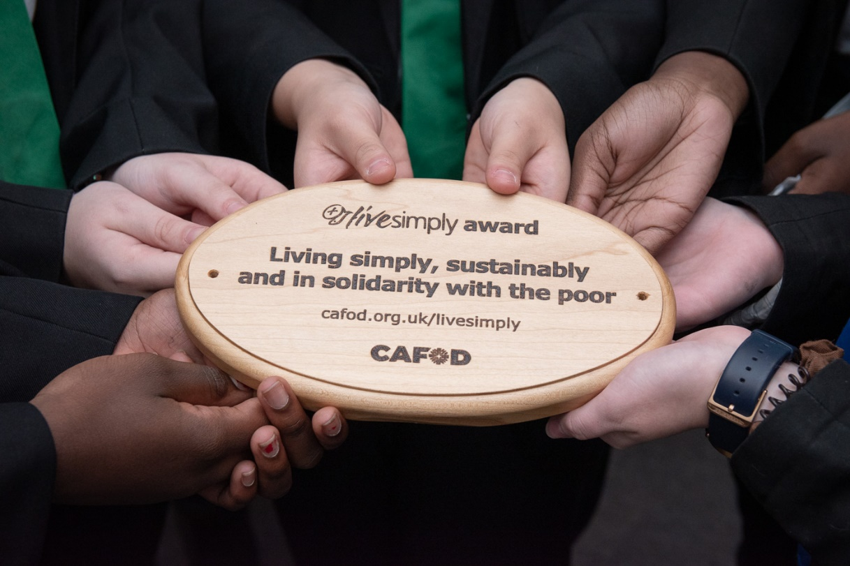
Friday 10 December
“I, the Lord your God… lead you
in the way that you must go.”
Isaiah 48:17
  Finding the way
  In the last few years, many parishes have achieved our livesimply award by taking steps to live simply, sustainably and in solidarity with the poor.
  St Thomas More School, Walsall also took part and received their award this year after involving the whole school in a range of actions – from fundraising for our global neighbours and campaigning on climate change to improving the school garden and ending use of plastic cutlery in the canteen.
Notes:
Picture credit: Sarah McPhee

Slide 28
  Laurna in Year 11 commented that working for the award made her realise that, “When we care for the world we come closer to God as his stewards”.
  Advent is a good time to think:
  Where is God leading me?
  What does God want me to do?
  Lord, lead me on the way that I should go.
  Amen.
“I, the Lord your God… lead you
in the way that you must go.”
Isaiah 48:17
Find out about the livesimply award
Notes:
Picture credit: Sarah McPhee

Slide 29
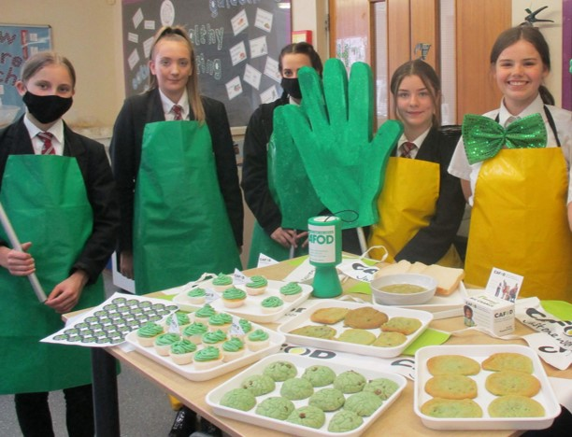
Saturday 11 December
“Elijah has come already and they did not recognise him…”
Matthew 17:12
  Go Green Harvest
  At Harvest, we asked schools to do Go Green fundraising to brighten up the world.
  Around England and Wales we saw pea green soup lunches going on, students dressing in green or dying their hair green, bright green bake sales… and many more creative ways to do green fundraising!
  You recognised the need and responded.
Use our World Gifts Christmas poster to replace cards in class this year.
Notes:
Picture credit: Angela Eddy

Slide 30
  In today’s gospel, people did not recognise that the spirit of the Prophet Elijah, whose return had been awaited, was present in John the Baptist.
  Perhaps people didn’t want to see. Recognising the truth of what is going on around us obliges us to do something about it.
  What is happening around me that I have not recognised?
  God of Wisdom, help me to
  see the truth and to accept the challenge to respond.
  Amen.
“Elijah has come already and they did not recognise him…”
Matthew 17:12
Remind yourself of our Go Green harvest film for Family Fast Day.
Notes:
Picture credit: Angela Eddy

Slide 31
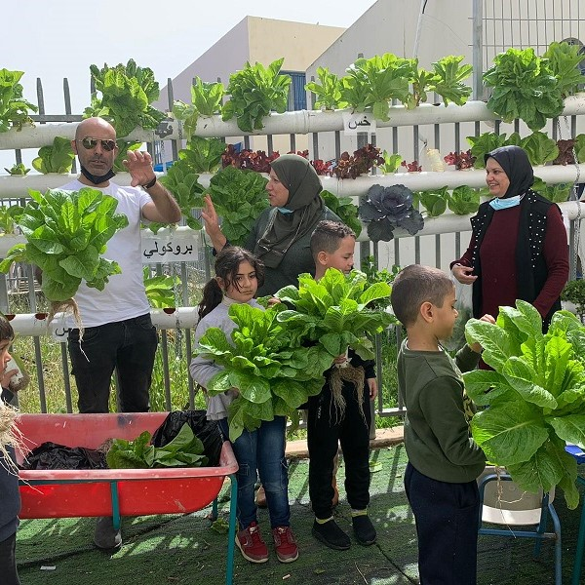
Sunday 12 December
Third Sunday of Advent
Gaudete (Rejoice) Sunday
“I exult for joy in the Lord,
my soul rejoices in my God…”
Isaiah 61:10
  Growing joy!
  A CAFOD-supported project has been training Palestinian citizens of Israel to use ‘hydroponics’ – to grow plants with water but no soil.
  Nijme used her training to teach nursery children how to grow lettuces. Now the hydroponics group can even sell their produce.
  Nijme found a restaurant that was interested: “The first time I took the harvest to the restaurant some kids and parents joined me, and you have never seen such joyful faces.”
Notes:
Picture credit: MAAN

Slide 32
  Today is ‘Rejoice Sunday’. The vestments used at Mass are pink to remind us to be joyful!
  Growing food brought much joy to Nijme, and it brought joy to many others when she shared what she had learned.
  What has brought you joy this Advent?
  How can you share it?
  Lord, help me bring joy!
  Amen.
“I exult for joy in the Lord,
my soul rejoices in my God…”
Isaiah 61:10
Order World Gifts by 15 December for free postal delivery by Christmas.
Notes:
Picture credit: MAAN

Slide 33
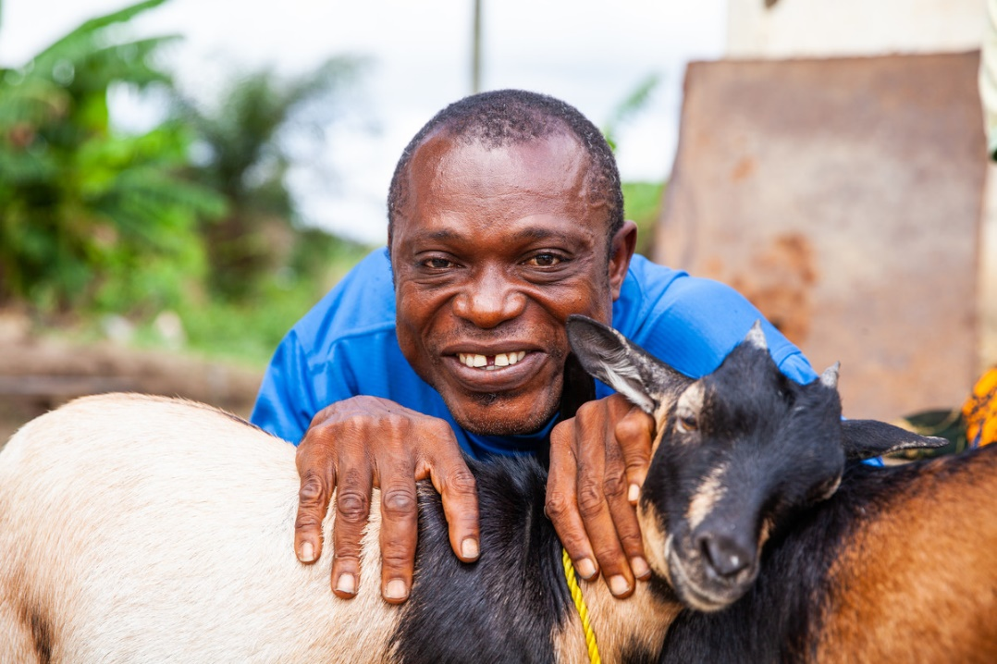
Monday 13 December
“I see him, but not in the present,
I behold him, but not close at hand.”
Numbers 24:17
  Looking to the future
  Ishmael Sesay has physical disabilities and difficulty walking. His wife, Lucia, is partially deaf.
  The Handmaid Sisters, who CAFOD works with in Sierra Leone, have loaned the family two goats from a ‘goat bank’ so that they can start a herd.
  There are few amenities in this remote area to support people living with disability and very few opportunities for formal employment. But with the Sisters’ support, Ishmael and Lucia have begun to establish themselves..
Notes:
Picture credit: Thom Flint

Slide 34
  In today’s reading, the prophet Balaam sees a future leader who would save his people. Centuries later, Jesus was born.
  Ishmael sees a future herd of goats helping to provide for his family.
  It can take courage to trust that a vision will be fulfilled.
  What is your vision for the future?
  Lord, give us clear vision and strong trust in you.
  Amen.
“I see him, but not in the present,
I behold him, but not close at hand.”
Numbers 24:17
Is CAFOD's agenda for change similar to your vision for the world?
Notes:
Picture credit: Thom Flint

Slide 35
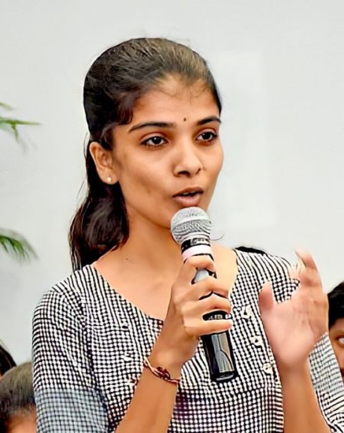
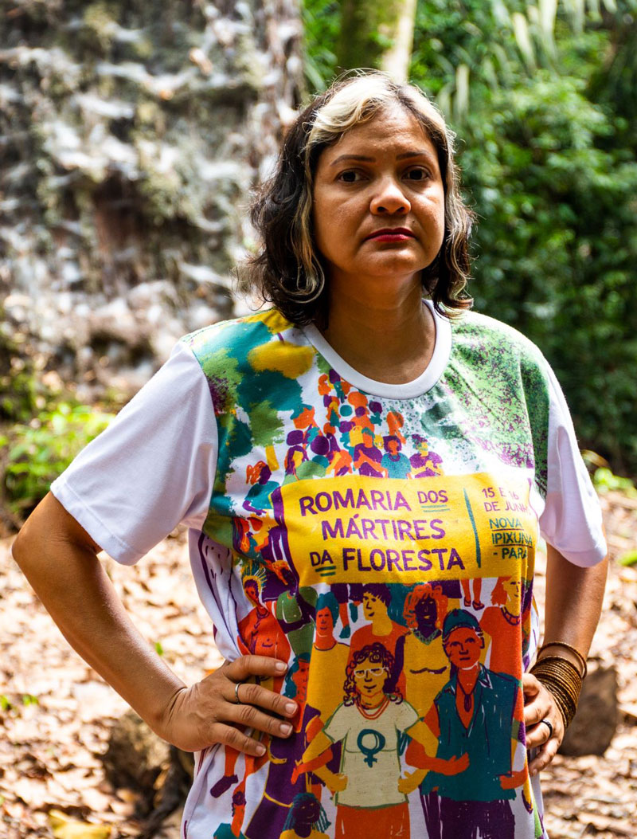
Tuesday 14 December
“The son answered ‘I will not go’ but
afterwards thought better of it and went…”
Matthew 21:31
  Young award winner
  Anojitha Sivaskaran, who works with a CAFOD partner in Sri Lanka, this year won the Diana Award, which honours young people for their social action.
  Anojitha’s education was disrupted by civil war and she lived in a refugee camp before completing her studies and going to university.
  Now she works for peace between young people of different ethnicities:
  “I believe that if young people work together, there’s nothing that cannot be achieved.”
Notes:
Picture credit: Groundviews.

Slide 36
  In today’s reading, the brother who at first refused to work, later changes his mind and goes to work in his father’s vineyard.
  Advent is a good season to remember the times we have not done what we ought to have done… and to get on with it!
  As Anojitha knows, actions count.
  What have I neglected to do?
  Lord, I’m sorry that I sometimes avoid your call. Help me to change course and to serve others as you did.
  Amen.
“The son answered ‘I will not go’ but
afterwards thought better of it and went…”
Matthew 21:31
Find out if your school or parish has an Advent reconciliation service.
Notes:
Picture credit: Groundviews

Slide 37
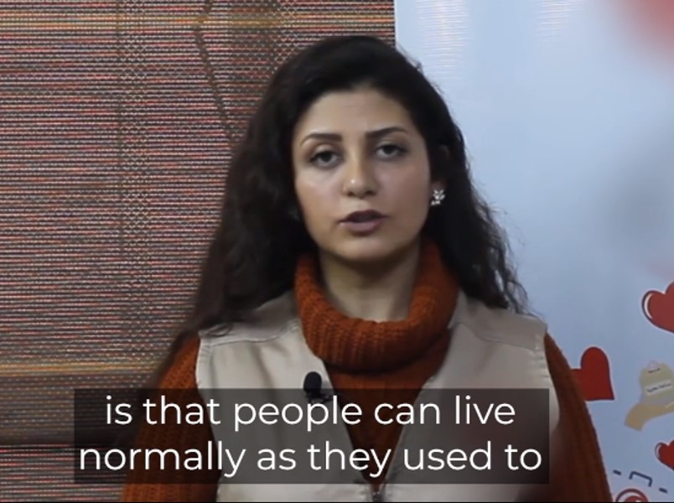
Wednesday 15 December
“I will hear what the Lord God has to say,
a voice that speaks of peace.”
Psalm 84:9
  Hope for peace
  Ten years after devastating conflict in Syria began, millions of people are still suffering its effects.
  CAFOD works with brave local experts in Syria - voices of peace and keepers of hope in a society torn apart by conflict.
  We asked some of them to tell us their hopes for the future.
  One said, simply, “that people can live normally as they used to, and stand on their own two feet.”
Notes:
We cannot reveal the names of our local experts in Syria, for their own security.

Slide 38
  Today’s psalm reminds us that God too is a voice of peace.
  God may want to speak peace to our own hearts or to tell us how we can be peace to someone else.
  Where can you find space to listen to God today?
  Lord, speak peace to my heart today.
  Amen
“I will hear what the Lord God has to say,
a voice that speaks of peace.”
Psalm 84:9
Watch our video to hear some other Syrians’ hopes (1:15 – 2:25)
Notes:
We cannot reveal the names of our local experts in Syria, for their own security.

Slide 39
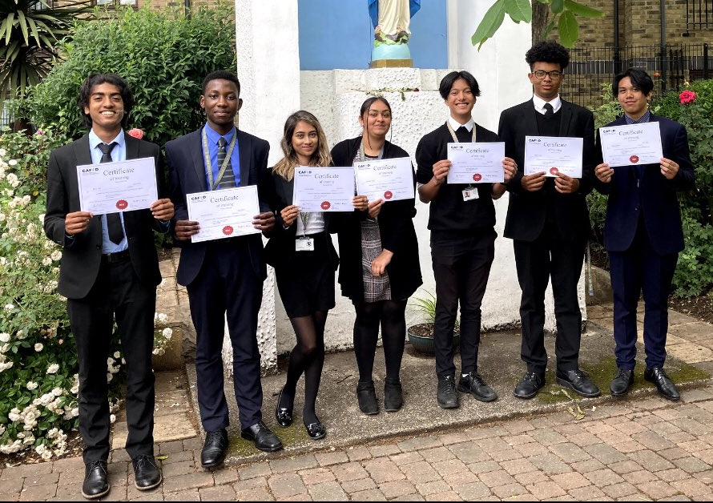
Thursday 16 December
“The sceptre shall not pass from Judah… until he comes to whom it belongs…”
Genesis 49:10
  Young leaders
  The photo shows some of this year’s graduates from CAFOD’s young leaders programme.
  197 young people in 31 schools committed to spend time in training meetings and webinars, learning new skills, meeting new people, campaigning and fundraising.
  One student said the programme “widened my eyes to the reality of the impact of human actions on Earth and how there is still work to do in order to improve others' lives.”
Notes:
Picture credit: St Bonaventure's RC School, Forest Gate

Slide 40
  Today’s Mass readings are all about God’s promise, fulfilled in Jesus.
  What promise or commitment can I make for the coming year?
  Lord, this Advent, help me to fulfil the promises I make.
  Amen.
“The sceptre shall not pass from Judah… until he comes to whom it belongs…”
Genesis 49:10
Write a new year’s resolution and put it somewhere visible.
Notes:
Picture credit: St Bonaventure's RC School, Forest Gate

Slide 41
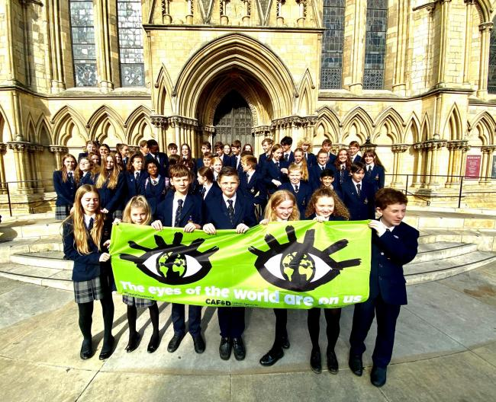
Friday 17 December
“…these same works of mine testify that the Father has sent me.’”
John 5:36
  Eyes and a turtle
  In October, students from All Saints Catholic School took part in CAFOD's Eyes of the World banner tour in front of York Minster.
  Sophie, 12, said “The Eyes of the World campaign is really important because it’s about our future. We can see what’s happening, we’re not oblivious to it…”
  Sophie also wrote a poem about plastic pollution, called 'Turtle‘ and read it on Radio York (listen from 1:55:35 – 1:58:02).

Slide 42
  It is easy to feel overwhelmed by the scale of the climate crisis and the loss of biodiversity. But we do have the power to turn things around, if we work together.
  Today’s gospel reminds us that God sent Jesus, and Jesus sends us. Our actions and our words can speak loudly about the way we care for creation, and why.
  Lord, remind me of your power when I feel overwhelmed.
  Amen.
“…these same works of mine testify that the Father has sent me.’”
John 5:36
Listen to Sophie’s poem and think how you could encourage care of creation.

Slide 43
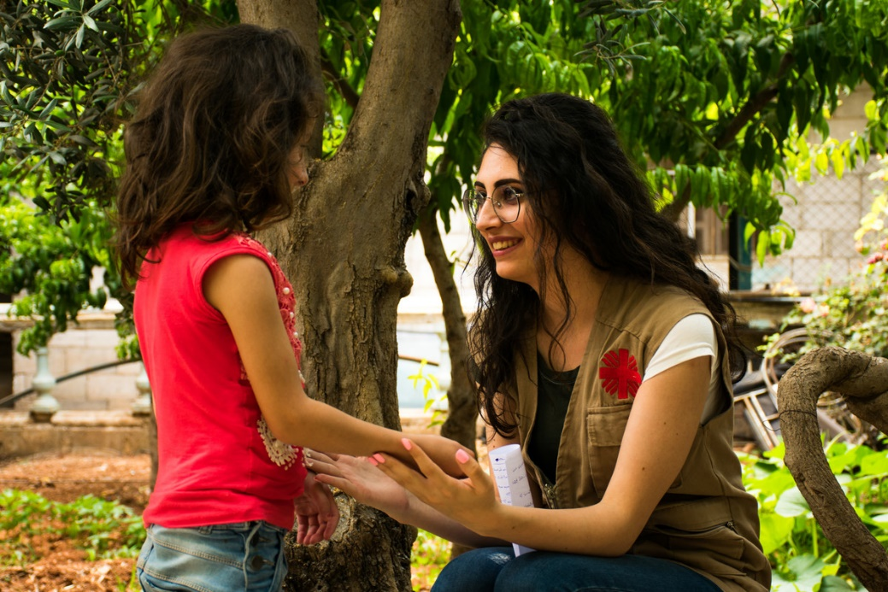
Saturday 18 December
“I was sent to speak to you and to announce to you this good news.”
Luke 1:19
Good news travels
  In today’s gospel, the angel is sent to tell Zechariah the good news that his wife, Elizabeth, will have a baby.
  Can you recall sharing a bit of good news with your friends or family? How did it feel?
  Today’s passage is from the start of Luke’s gospel. It’s a hint of things to come. All through this gospel Jesus proclaims the good news of the kingdom of God. He sends out his followers to proclaim it too.
Notes:
Picture credit: Abd Al Hameed Moneer Al Haj Younes and Kamel Awad

Slide 44
  We are his disciples today.
  It is only a few days now before we celebrate the good news that Jesus was born for us. Sometimes that joyful message can seem lost behind tinsel and lists of presents.
  How will you remind people of the real good news of Christmas?
  Jesus, your birth is a joyful message of hope for all people who are suffering. Help me to share it.
  Amen
“I was sent to speak to you and to announce to you this good news.”
Luke 1:19
Put together a message that will share the joy of Christmas and bring hope.
Notes:
Picture credit: Abd Al Hameed Moneer Al Haj Younes and Kamel Awad

Slide 45
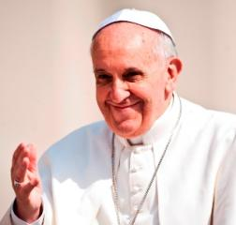
Sunday 19 December
Fourth Sunday of Advent
“Let what you have said be done to me.”
Luke 1:38
  Living Word
  The Bible is a place we can go to seek wisdom about how to live.
  For example, Pope Francis said:
  “Biblical revelation urges us to welcome the stranger; it tells us that in so doing, we open our
  doors to God, and that in the faces of others we see the face of Christ himself.”
Notes:
Picture credit: Mazur/Catholicnews.org.uk

Slide 46
  In today’s gospel, Mary accepts the angel’s words and her calling to become the mother of Jesus. What can this scripture teach us?
  Sometimes we see acceptance as weakness. Mary is evidence that this is not so. She was a strong young woman facing a huge challenge.
  What might I need to accept?
  Mary, pray for me to accept what God is calling me to do and to respond as generously as you did.
  Amen.
“Let what you have said be done to me.”
Luke 1:38
Look out for opportunities to say ‘yes’ today when you are asked to help.
Notes:
Picture credit: Mazur/Catholicnews.org.uk

Slide 47

Monday 20 December
“...'Emmanuel', a name which means
'God-is-with-us.'"
Isaiah 7:14
  God is with us
  In the last few days of Advent as the holidays begin, are you looking for some inspiring viewing?
  There are loads of great films and documentaries about care of creation and service of others.
  The Boy Who Harnessed the Wind is the true story of William Kamkwambe, a 13-year-old boy in Malawi, who found a way to save his community from drought by repurposing ordinary items rescued from the scrap heap.

Slide 48
  Centuries ago, the prophet Isaiah said that God would come to be with us. His words were fulfilled when Jesus was born.
  God is still here with us in our ordinary lives, and will help us to transform the ordinary into the extraordinary as we love and serve God and each other.
  Where can you see God living with us today?
  Emmanuel, thank you for coming to live with us. Help me to see you in my ordinary life.
  Amen
“...'Emmanuel', a name which means
'God-is-with-us.'"
Isaiah 7:14
Tell a friend one film, song or story that has inspired you.

Slide 49
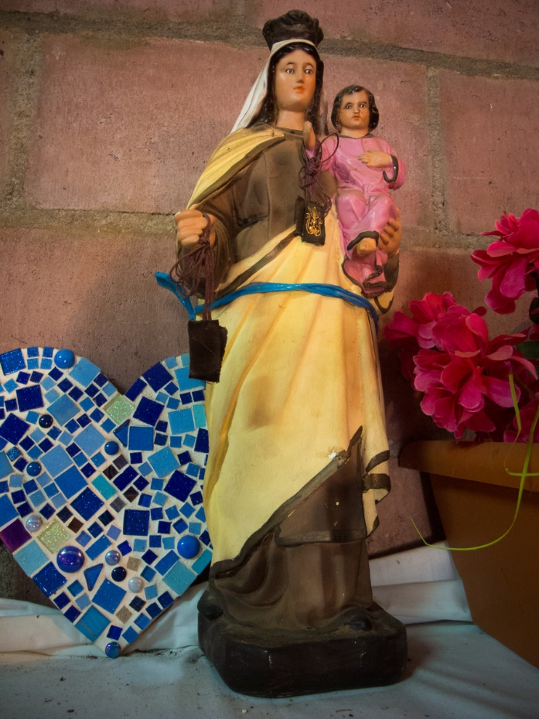
Tuesday 21 December
“Blessed is she who believed that the promise made her by the Lord would be fulfilled.”
Luke 1:45
  I don’t believe it!
  How often do we say “I don’t believe it” or even “I can’t believe it” when something outrageous happens?
  Mary could justifiably have said the same to the angel, Gabriel.
  “Son of God? The power of the Lord will overshadow me? I don’t believe it! What about Joseph?”
  But Mary chose to believe the outrageous promise of the Lord.
Statue in Puentecitos, El Salvador
Notes:
Picture credit: Tania Dalton/CAFOD

Slide 50
  Elizabeth, in today’s reading, tells Mary she is blessed because of her choice to believe the Lord’s word.
  Which Bible verse speaks most strongly to you? One that means a lot to us at CAFOD is: “He sent me to bring good news to the poor.”
  If you’re not sure, dust off that Bible or search that app and see what jumps out at you. Perhaps God has a special word for you today.
  Jesus, thank you for your promises. Help me to believe. Amen.
“Blessed is she who believed that the promise made her by the Lord would be fulfilled.”
Luke 1:45
Read and think about a word or phrase from scripture.
Notes:
Picture credit: Tania Dalton/CAFOD

Slide 51
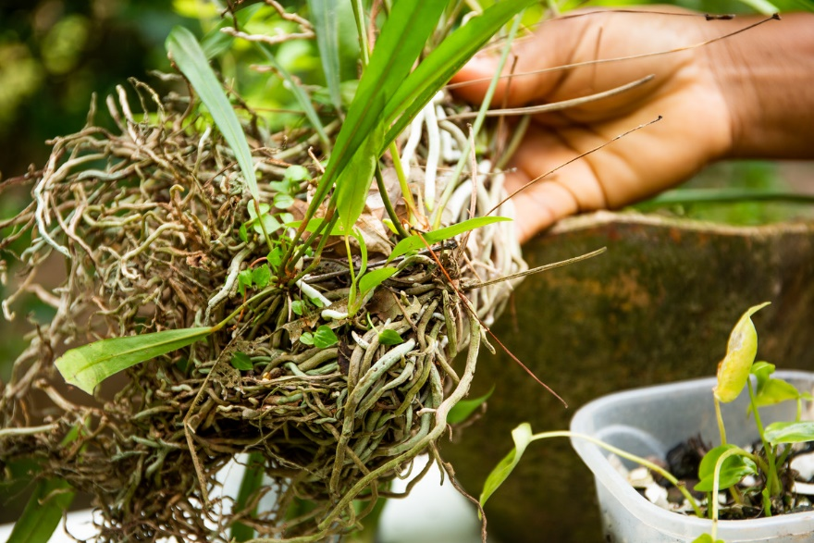
Wednesday 22 December
“…the Almighty has done great things for me, and holy is his name."
Luke 1:49
  Replanting trees
  At Harvest, we shared the story of Luana and her grandmother whose community’s vegetable plots in the Brazilian Amazon had been destroyed by forest fires.
  The photo shows a sapling that one of their community, Joseilton, was preparing to plant on his land.
  He told us: "After the fire, for a while I didn’t plant anymore… I’m going to plant them there, where the banana trees burnt, and I am going to try and start up again."
Notes:
Picture credit: Thom Flint/CAFOD

Slide 52
  Today’s reading is the Magnificat, the revolutionary song of Mary that is so vocal about God’s defence of oppressed people that it was banned by at least three governments in the last century.
  (See if you can find out which - you may be surprised!)
  Let us pray that God will defend the oppressed, including those who defend the Amazon, and that we will stand beside them too.
  Lord, help us to build a world where everyone has a voice and is listened to with respect.
  Amen
“…the Almighty has done great things for me, and holy is his name."
Luke 1:49
Plant an apple seed or an acorn in a pot on your windowsill and care for it.
Notes:
Picture credit: Thom Flint/CAFOD

Slide 53
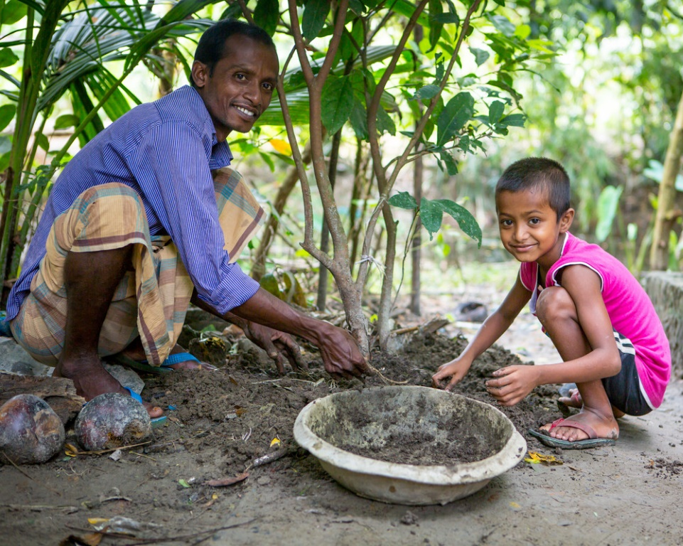
Thursday 23 December
“‘What, then, will this child be?’
For surely the hand of the Lord was with him.”
Luke 1:66
  Planting new trees
  In Bangladesh, Suchandra catches and sells crabs for income but it’s not enough to look after his family. They are still paying off loans from rebuilding their home after a cyclone in 2013.
  Here Suchandra and his son, Shoyon, are caring for tree saplings grown from seeds provided at a Caritas Bangladesh seed fair.
  Since 2019, we have been supporting Suchandra's family and neighbours to plant crops that will grow even in the changing climate.
Notes:
Picture credit: Louise Norton/CAFOD

Slide 54
  They may be small now, but Suchandra’s saplings will become trees producing fruit for eating and selling.
  In today's reading, people talk about what John the Baptist might become. They can see that the Lord is with him and know this means he will be amazing.
  And the Lord is with you too! With God's help, we can all be amazing.
  Lord, let your hand be with me to shape me into the best person I can be. Do amazing things through me.
  Amen.
“‘What, then, will this child be?’
For surely the hand of the Lord was with him.”
Luke 1:66
Find out about volunteering in your local community or with CAFOD.
Notes:
Picture credit: Louise Norton/CAFOD

Slide 55
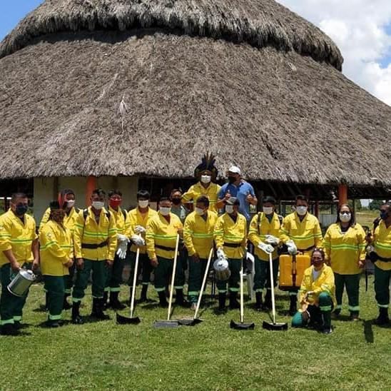
Friday 24 December
Christmas Eve
“...the dawn from on high shall break upon us,
to shine on those who dwell in darkness…”
Luke 1:78-79
  Waiting in hope
  In parts of the Amazon, with the climate crisis making summers hotter and drier, fires happen more often. Intense and prolonged droughts can produce “hot spots” and, without proper management, forest fires can easily spread.
  Volunteer indigenous firefighters monitor hot spots, manage the land and put out fires before they spread. Funding from CAFOD provides access to the tools they need to help with this land management.
Notes:
Picture credit: Indigenous Council of Roraima

Slide 56
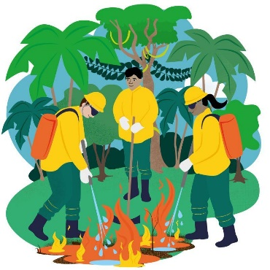
  Our Christmas Eve reading reminds us that “the dawn from on high”- Jesus, Light of the World - was coming to be with us.
  Jesus’ birth in a stable is a powerful sign that God chose to share in our lives – the problems as well as the joys.
  How will I let his light shine on and through me?
  Lord, thank you for communities that work together to address problems. Help me to build up my local community to do the same. Amen.
“...the dawn from on high shall break upon us,
to shine on those who dwell in darkness…”
Luke 1:78-79
Find out about our new World Gift, Fight fires in the Amazon.
Notes:
Picture credit: Indigenous Council of Roraima

Slide 57
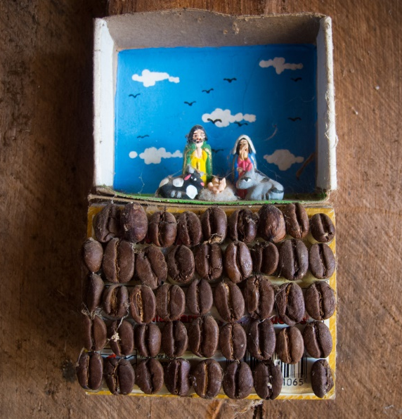
Saturday 25 December
Christmas Day
“The shepherds went back glorifying and praising God…”
Luke 2:20
  Good news to share
  Today we celebrate the greatest gift of all – Jesus, given to us by the Father, born to bring good news to the poor.
  The crib pictured is in a home in a poor rural region of El Salvador, where CAFOD works alongside farming communities that live close to the land. The nativity scene is decorated with coffee beans, one of the local crops.
Notes:
Picture credit: Tania Dalton

Slide 58
  Today we thank God for the hope he gives us, that he will help us to build a just and sustainable world where all have the resources they need to live life to the full.
  Like the shepherds – we rejoice!
  Jesus, you enter into our poverty and transform it. Empower me with hope to live and share your good news for all.
  Amen.
“The shepherds went back glorifying and praising God…”
Luke 2:20
Say a Christmas grace before meals to say thank you for all God’s blessings.
Notes:
Picture credit: Tania Dalton

Slide 59
Thank you for journeying with us this Advent.
Everyone at CAFOD wishes you a happy and holy Christmas.
Picture credits: See notes fields of the slides
Illustrator: Sam Osborne
Notes:
Picture credit: Tania Dalton

